Slide 1

EE 534 Advanced Object-Oriented programming term project Progress Report CLUSTER MANAGER April 2011
Melih Koca, İlke Muhtaroglu, Nitel Muhtaroglu

Slide 2
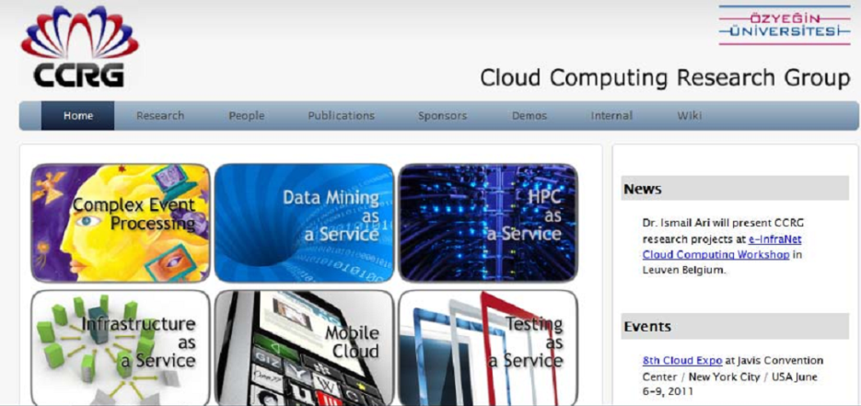
Our motivations
The need for efficient management of a cloud computing infrastructure.
Handling challenges like QoS, maximum throughput vs. minimum latency.

Slide 3





Technology Used
Hardware:
IBM Blade Center H with 6 IBM Blade H22
OS:
Red Hat Enterprise Linux 5
Web Portal:
Liferay
System Monitoring:
Hyperic Open Source
Programming Language:
Java

Slide 4
Patterns Used
There is a total of six patterns used:
1) Our design is based on Model-View-Controller Pattern.
(In this term project we will be implementing the code for the Model section.)
2) Façade Pattern
3) Factory Method
4) Observer
5) State
6) Strategy

Slide 5
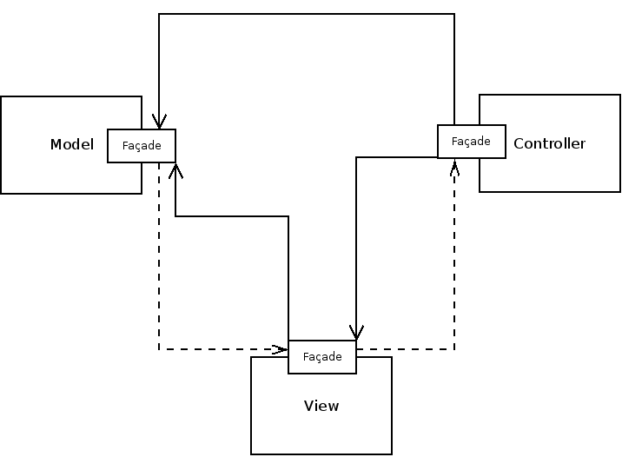
M-V-C Pattern
By using this pattern we isolate the cluster management logic from the web portal’s presentation and input mechanisms.
This lets us have an independent development process.
Notes:
Both MPI and MapReduce installed as distributed processing layers
Helps us compare two strategies
Cheap PC based clusters and high-end clusters.
An undergraduate student did this Visio plot for the IBM systems: In fact 2 of my undergrad students are doing intern at IBM Turkey right now
I am ordering 4 more HS22 servers when I get back

Slide 6
Façade Pattern
Using this interface give us the opportunity to control complex subsystems by interacting only with one class.

Slide 7
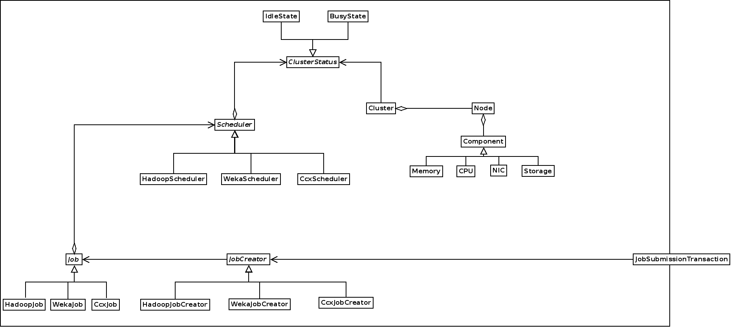
Factory Method

Slide 8
Observer

Slide 9
State

Slide 10
Strategy

Slide 11
Future Work
Development of detailed Class Diagrams.
Integration of Hyperic API into Eclipse IDE.
Coding of the classes.
Testing the scheduler with different job load scenarios.

Slide 12
Thank You! Questions?

